Slide 1

Web Crawler

Slide 2
Content aggregator
…..more apps…
Web
Web archive
Web Crawler (a.k.a bot or spider)
Web monitoring services
Search engine

Slide 3


Role of Content Aggregator
……
Source 1
Source 2
Source n
Content Aggregator

Slide 4
Web Archive
Example : archive.org, have 20+ years of web history and contains 830 billions of web pages, 20 millions of book, 4.5 millions of recording, 4 million of videos
What to do with these archive
Wealth of information
A library
At the downtime of web host

Slide 5
Web Monitoring Services
To monitor the uptime of the website

Slide 6
Information a Crawler Need
When was the page last updated?
Does the owner want this page “not” to be searchable
What meta-information would a crawler like to know about a page?
Are there more related pages on the site?
Importance of the page
How frequently does the page get updated

Slide 7
How to get the Previously Mentioned Information
Sitemap.txt: for any website go to sitemap generator and place the URL of the website
Robot.txt

Slide 8
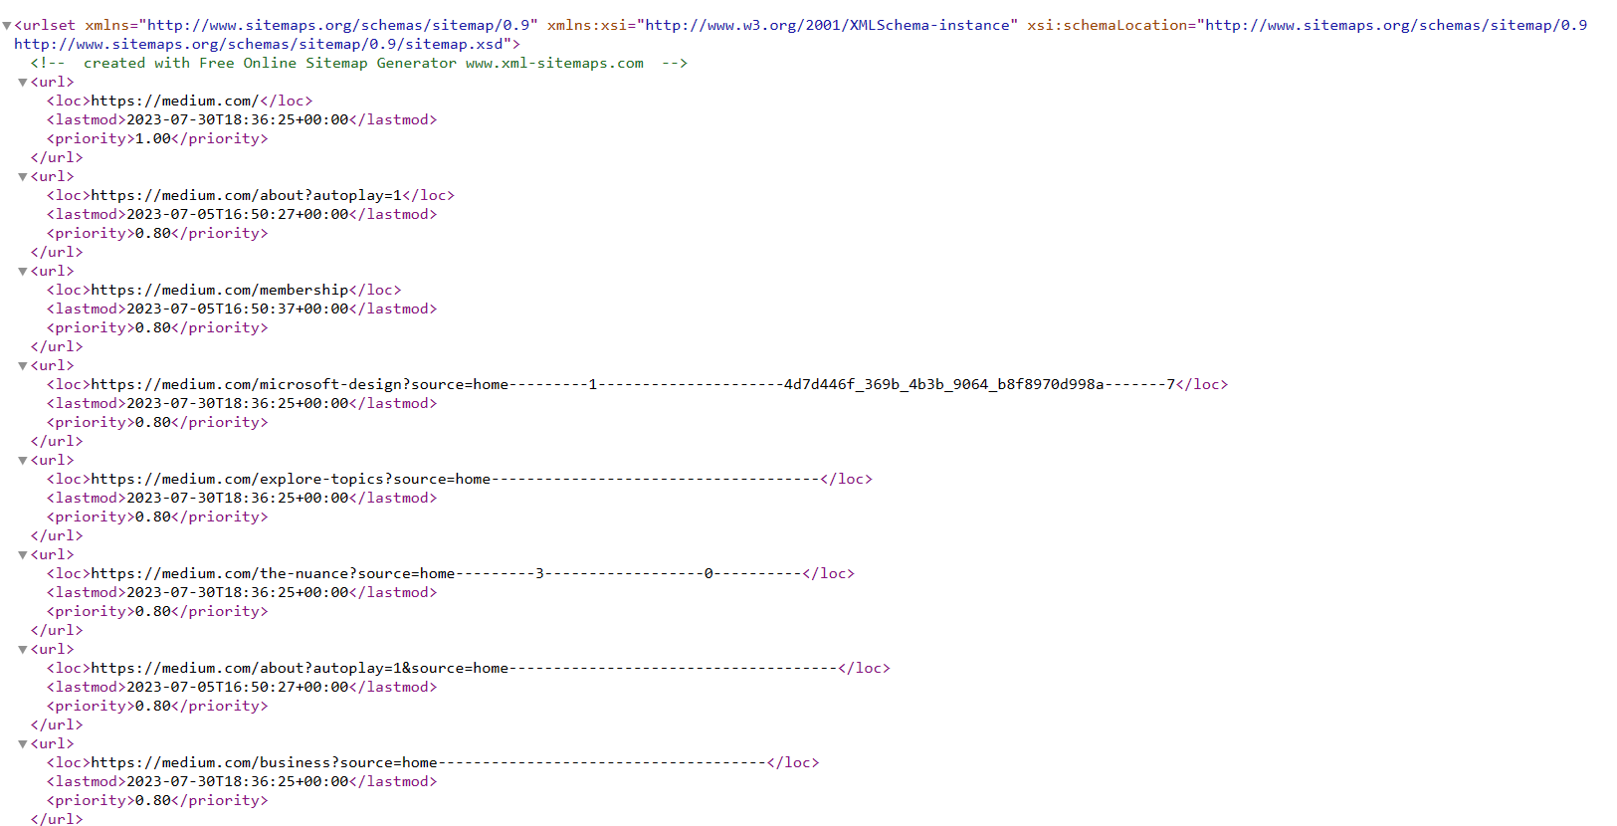
Sitemap

Slide 9
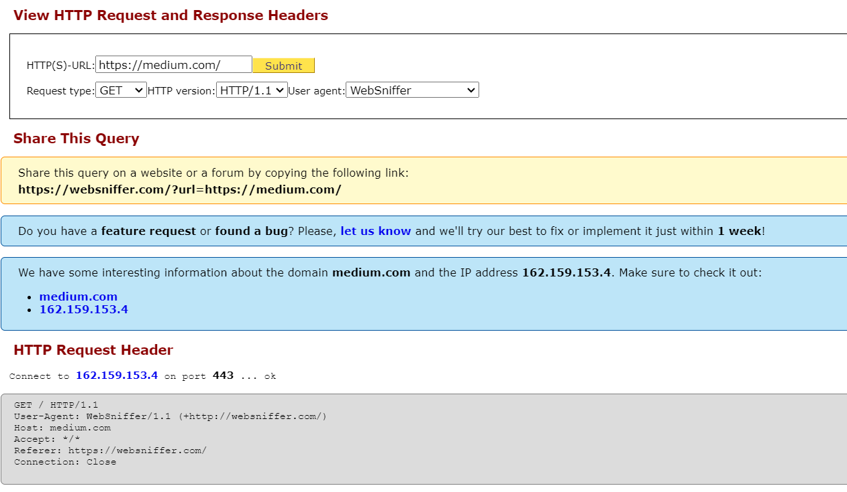

Slide 10
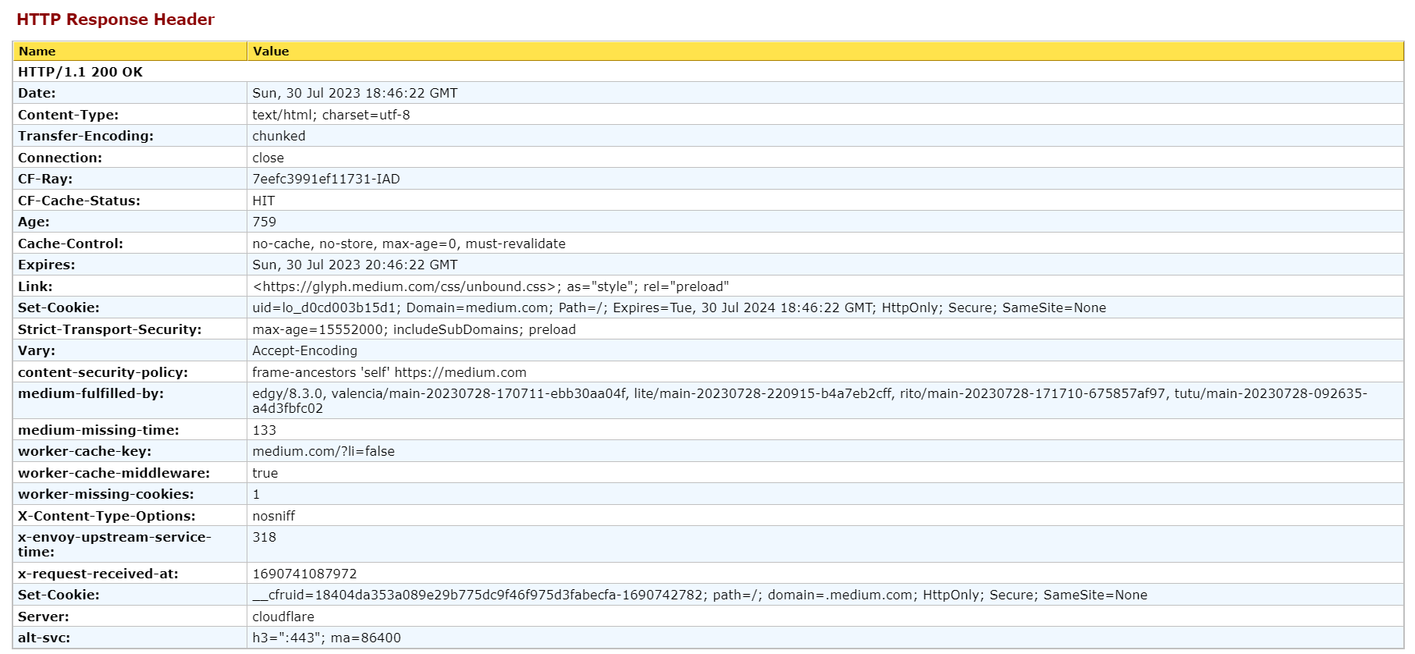

Slide 11
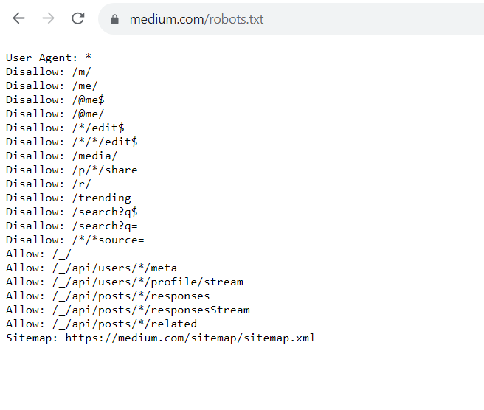
Robots.txt

Slide 12
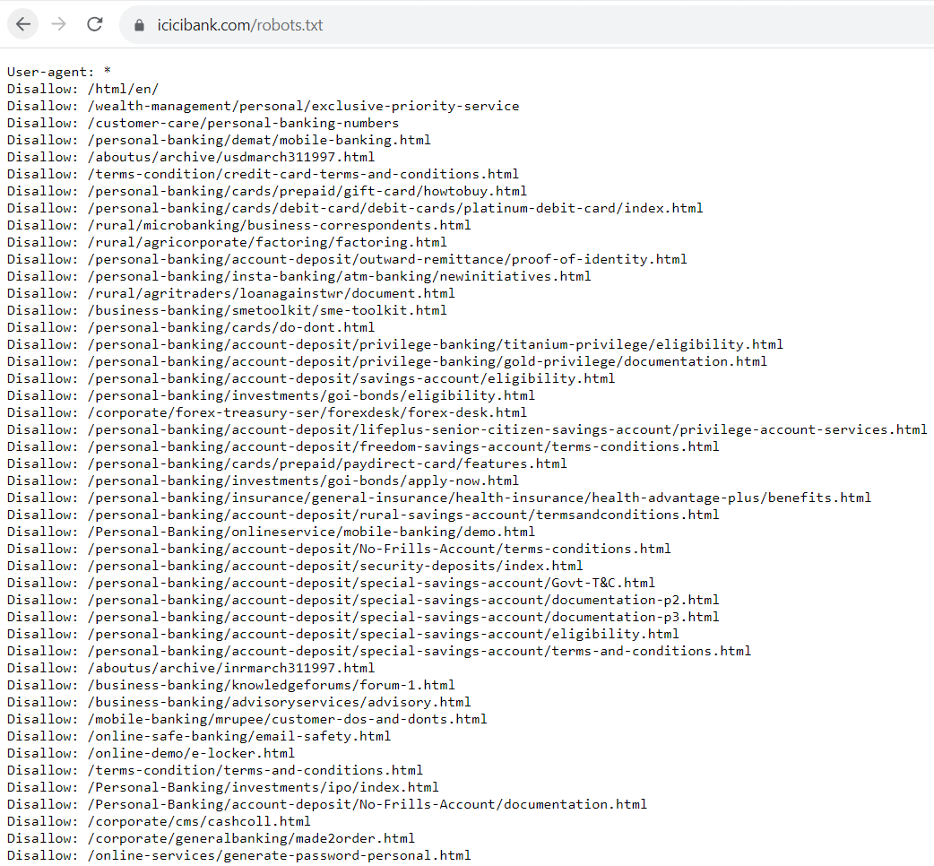
Robots.txt

Slide 13
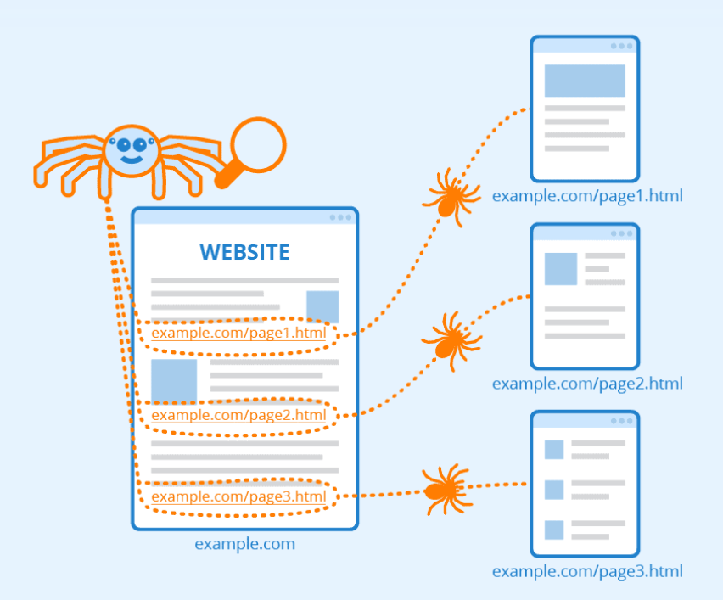
EXAMPLE OF

Slide 14
A Basic Crawl Algorithm
Seed URL
Download web pages
Extract Links
No more Links to fetch
Unvisited Link Available
Yes

Slide 15
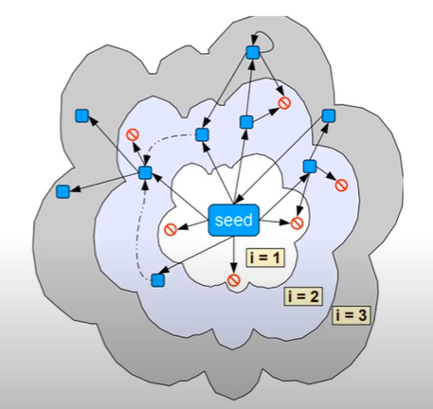
Basic Crawler Operation
Begin with known “seed” URL
Fetch and parse them
Extract URLs they point to
Place the extracted URLs on a queue
Fetch each URL on the queue and repeat

Slide 16
Challenges and Complication in Crawling
Scaling: Web crawling is not feasible with one machine
Malicious pages
Spam pages
Spider traps- include dynamically generated
Even non malicious pages pose challenges
Latency( bandwidth to remote servers vary)
Webmaster’s stipulations
How deep should you crawl a site URL hierarchy?
Site mirror & duplicate pages
Politeness

Slide 17
Challenges (Contd..)
Can I get high value content quickly
Coverage and freshness
How to be fair?
Politeness
Beware of adversaries

Slide 18
Scaling to the Web
Caching
Cache IP address to avoid repeated DNS lookup
Cache robots.txt
Avoid fetching duplicate pages
Remember fetched URLs
Prioritize
For freshness

Slide 19
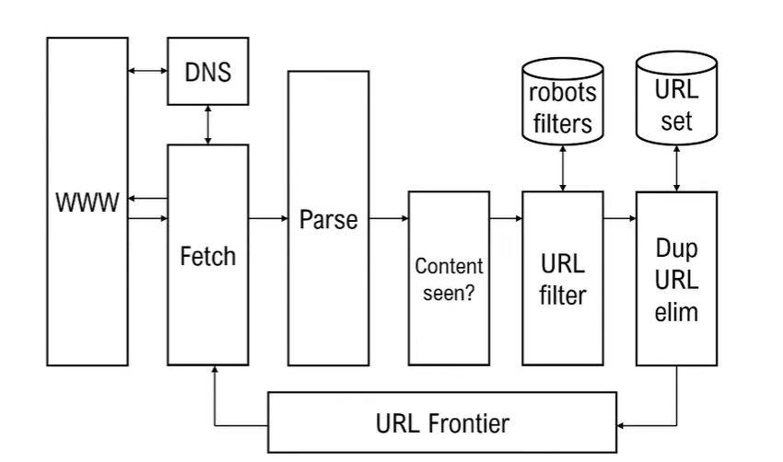
Scalable Crawl Architecture

Slide 20
Data Structure
A queue of URLs/website
Allows throttling the access per site
Dequeue an URL → Download the page → Extract URLs → Add them to queue → Iterate
A bloom filter to avoid revisiting same URL.

Slide 21
Bloom Filter
A bloom filter is a space –efficient probabilistic data structure that is used to test structure that is used to test whether an element is a member of a set.
Working of bloom filter
An empty bloom filter is a bit array of m bits, all set to zero.
We need k number of hash function to calculate the hashes for a given input.
To add an item the bits at k indices h1(x), h2(x),..,hk(x) are set. Indices are calculated using hash function.
0 | 0 | 0 | 0 | 0 | 0 | 0 | 0 | 0 | 0
1 | 2 | 3 | 4 | 5 | 6 | 7 | 8 | 9 | 10

Slide 22
Example
0 | 0 | 0 | 0 | 0 | 0 | 0 | 0 | 0 | 0
1 | 2 | 3 | 4 | 5 | 6 | 7 | 8 | 9 | 10
Example “BIT”
h1(“BIT”)%10=1
h2(“BIT”)%10=4
h3(“BIT”)%10=7 BIT
Again “Bloom”
h1(“Bloom”)%10=3 BLOOM
h2(“Bloom”)%10=5
h3(“Bloom”)%10=4
1 | 0 | 0 | 1 | 0 | 0 | 1 | 0 | 0 | 0
1 | 2 | 3 | 4 | 5 | 6 | 7 | 8 | 9 | 10
1 | 0 | 1 | 1 | 1 | 0 | 1 | 0 | 0 | 0
1 | 2 | 3 | 4 | 5 | 6 | 7 | 8 | 9 | 10

Slide 23
Bloom Filter
If I want to check “BIT” is present or not, then repeat the same process in reverse order.
Compute the respective hashes using h1, h2 and h3 and check if all these indices are set to 1 in the bit array.
If all the bits are set to 1of corresponding bits then we can say that the “BIT” is probably present.
If any of the bits at these indices are 0 then “BIT” is not present
False positive in bloom filter
Can be controlled by the size of bloom filter

Slide 24
Frontier Expansion
A URL frontier is priority queue contains unseen URLs.
Starts with a seed URLs
Should we do BFS or DFS

Slide 25
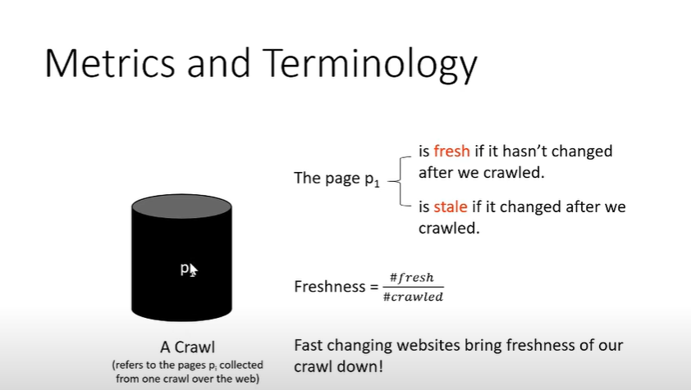
Metric and Terminology

Slide 26
Crawler Traps
Website can generate possibly infinite URLs
Often setup by spammers
Dynamically redirect to infinitely deep directory structure
Several Ideas to counter the traps has been suggested
Budget Enforcement with anti-spam “Budget Enforcement with AntiSpam Tactics” (BEAST)

Slide 27
Batch vs Incremental Crawling
Incremental crawling
Works with a base snapshot of web
Incrementally update the snapshot with new/ modified / removed pages
Works well for static web pages
Batch crawling
Easier to implement
Works well for dynamic web pages
Usually we mix both

Slide 28
What a Crawler Must Do?
Be Polite: Respect implicit and explicit politeness consideration
Only crawled allowed pages
Respect robots.txt
Be robust: Be immune to spider traps and other malicious behaviour from web server

Slide 29
What any crawler should do?
Fetch pages of higher quality first
Continuous operation: continue fetching fresh copies of a previously fetched page
Be capable of distributed operation: designed to run on multiple distributed machine.
Be scalable: designed to increase the crawl rate by adding more machine
Performance/Efficiency: Permit full use of available processing and network resources

Slide 30
Measure for a Search Engine
How fast does it index
No of document per hour
Average document size
How fast does it index
Latency as a fraction of index size
Expressiveness of query language
Ability to express complex information needs
Speed on complex queries

Slide 31
Measure for a Search Engine
All of the preceding criteria are measurable are measurable: we can quantify speed/sixe
The key measure: User Happiness
Speed of response/size of index are factors
But blindingly fast, useless answer won’t make a user happy
Needs a way to quantifying user happiness

Slide 32
Measuring User Happiness
Issue: who is the user
Web Engine:
User finds what s/he wants and return to the engine
Can measure rate of return
E-commerce site:
User finds what s/he wants and purchase
Can be measured in time to purchase or fraction of searches who becomes buyer
Enterprise (Company/Govt/Academic): care about “User productivity”
How much time do my user save when looking for information
Many other criteria having to do with breadth of access, secure access

Slide 33
Evaluating IR System
The information need is transfer into a query
Relevance is accessed relative to the information need not the query. Example?
Query: Wine Red White Heart Attack Effective
Information Need: I am looking for information on whether drinking red wine is more effective at reducing your risk of heart attack than white wine.
Evaluate whether the doc address the information need, not whether it has these words

Slide 34
Unranked Retrieval Evaluation
Precision and Recall:
Precision: fraction of retrieved docs that are relevant = P(Relevant/Retrieved)
Recall: fraction of relevant of relevant docs that are retrieved = P(Retrieved/Relevant)
P=TP/TP+FP
R=TP/TP+FN
 | Relevant | Non-Relevant
Retrieved | TP | FP
Not Retrieved | FN | TN

Slide 35
Precision and Recall
You can get high Recall (but low precision) by retrieving all docs for all queries.
Recall is a non-decreasing function of the number of docs retrieved
In a good system, precision decreased as either the number of docs retrieved or recall increases.
This is not a theorem but a result with strong empirical confirmation

Slide 36
F-measure
Combined measure that assesses precision /recall tradeoff is F-measure (weighted harmonic mean)
F-Measure=2*P*R/P+R

